Slide 1

International institute of professional studies,DAVV INDORE
STP OF Online Student Registration System
Submitted by :-
Vikas Kaushal
Roll_No.: IT-2K19-71
MTECH-IT

Slide 2
Software Test Plan (STP) for Online Student Registration system
The Software Test Plan (STP) describes plans for qualification testing of Computer Software Configuration Items (CSCIs) and software systems. It describes the software test environment to be used for the testing, identifies the tests to be performed, and provides schedules for test activities.

Slide 3
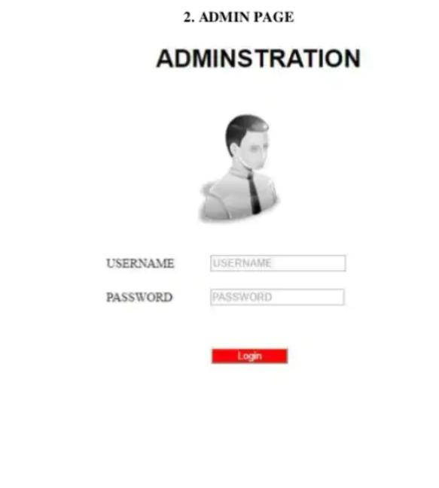

Slide 4
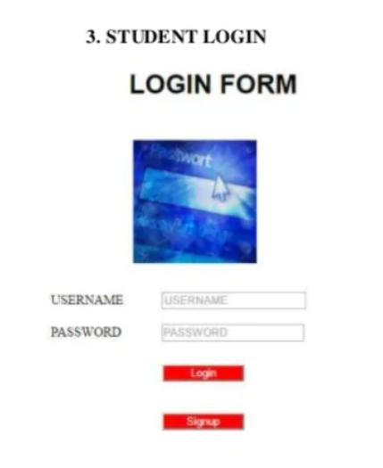

Slide 5
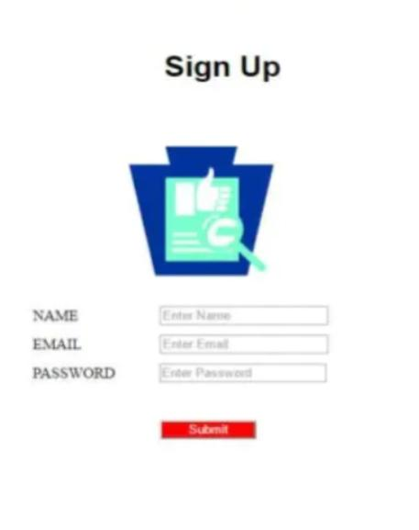

Slide 6
